Slide 1
Unit -4
Supervised Learning: Dual Use

Slide 2
Neural Network
An Artificial Neural Network (ANN) models the relationship between a set of input signals and an output signal using a model derived from our understanding of how a biological brain responds to stimuli from sensory inputs. Just as a brain uses a network of interconnected cells called neurons to create a massive parallel processor, ANN uses a network of artificial neurons or nodes to solve learning problems.

Slide 3
Artificial Neural Network
The study of artificial neural networks (ANNs) has been inspired in part by the observation that biological learning systems are built of very complex webs of interconnected neurons in brains.
ANNs are built out of a densely interconnected set of simple units, where each unit takes a number of real-valued inputs and produces a single real-valued output.

Slide 4
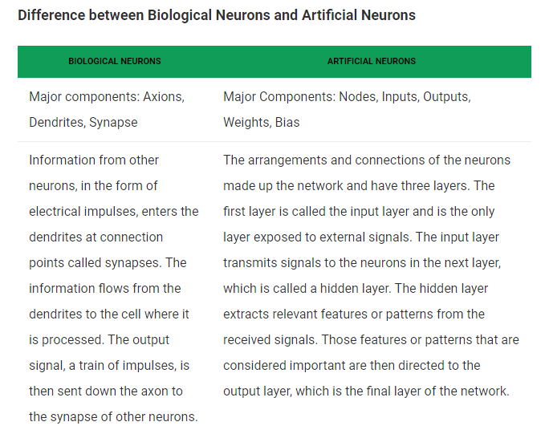

Slide 5
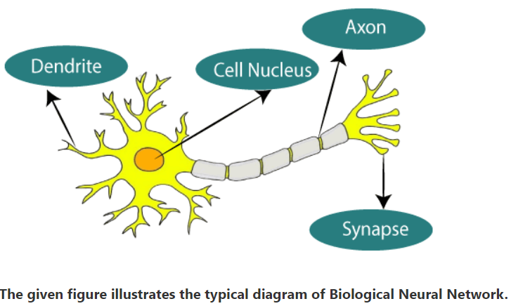

Slide 6
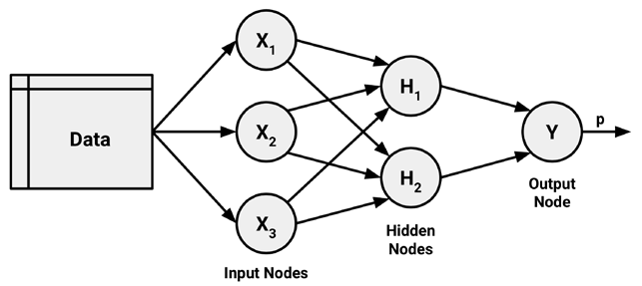
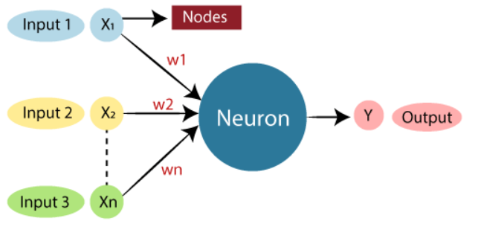
Notes:
Weights hv some information regarding the inut signal

Slide 7
Neural networks use neurons defined this way as building blocks to construct complex models of data. Although there are numerous variants of neural networks, each can be defined in terms of the following characteristics:
An activation function, which transforms a neuron's combined input signals into a single output signal to be broadcasted further in the network.
A network topology (or architecture), which describes the number of neurons in the model

Slide 8
as well as the number of layers and manner in which they are connected.
The training algorithm that specifies how connection weights are set in order to inhibit or excite neurons in proportion to the input signal.
Notes:
weights are the real values that are attached with each input/feature and they convey the importance of that corresponding feature in predicting the final output

Slide 9
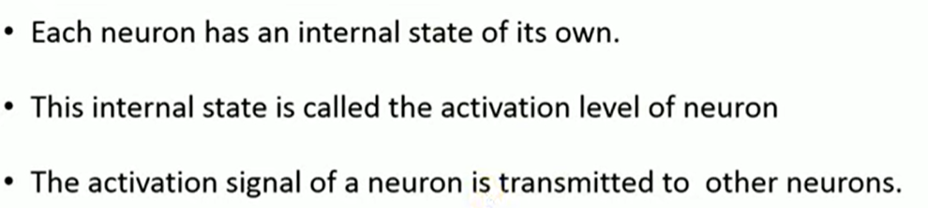

Slide 10
Advantage of Using Artificial Neural Networks
ANNs is used for problems having the target function output may be discrete-valued, real-valued, or a vector of several real- or discrete-valued attributes.
ANN learning methods are quite robust to noise in the training data. The training examples may contain errors, which do not affect the final output.
It is used generally used where the fast

Slide 11
evaluation of the learned target function may be required.
ANNs can bear long training times depending on factors such as the number of weights in the network, the number of training examples considered

Slide 12
Characteristics of Artificial Neural Network
It is neurally implemented mathematical model
It contains huge number of interconnected processing elements called neurons to do all operations
Information stored in the neurons are basically the weighted linkage of neurons
The input signals arrive at the processing elements through connections and connecting weights.
Notes:
. weights are the real values that are attached with each input/feature and they convey the importance of that corresponding feature in predicting the final output

Slide 13
It has the ability to learn , recall and generalize from the given data by suitable assignment and adjustment of weights.
The collective behavior of the neurons describes its computational power, and no single neuron carries specific information .

Slide 14
How simple neuron works
Let there are two neurons X and Y which is transmitting signal to another neuron Z . Then , X and Y are input neurons for transmitting signals and Z is output neuron for receiving signal . The input neurons are connected to the output neuron , over a interconnection links ( A and B ) as shown in figure .
For above neuron architecture , the net input has to be calculated in the way .
I = xA + yB
where x and y are the activations of the input neurons X and Y . The output z of the output neuron Z can be obtained by applying activations over the net input .
O = f(I)

Slide 15
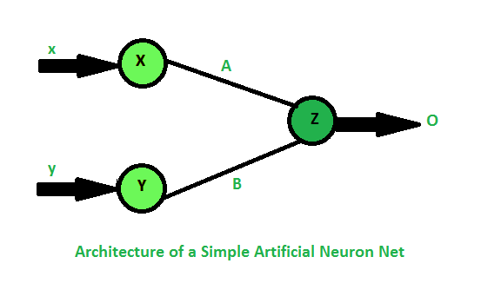

Slide 16
Application of Neural Network
1.Every new technology need assistance from previous one i.e. data from previous ones and these data are analyzed so that every pros and cons should be studied correctly . All of these things are possible only through the help of neural network.
2. Neural network is suitable for the research on Animal behavior, predator/prey relationships and population cycles .
3. It would be easier to do proper valuation of property, buildings, automobiles, machinery etc. with the help of neural network.

Slide 17
4.Neural Network can be used in betting on horse races, sporting events and most importantly in stock market .
5. It can be used to predict the correct judgement for any crime by using a large data of crime details as input and the resulting sentences as output.
6. By analyzing data and determining which of the data has any fault ( files diverging from peers ) called as Data mining, cleaning and validation can be achieved through neural network.

Slide 18
8. It can be used efficiently in Employee hiring so that any company can hire right employee depending upon the skills the employee has and what should be it’s productivity in future .
9. It has a large application in Medical Research .
10. It can be used to for Fraud Detection regarding credit cards , insurance or taxes by analyzing the past records .

Slide 19
Network Topology
The ability of a neural network to learn is rooted in its topology, or the patterns and structures of interconnected neurons. Although there are countless forms of network architecture, they can be differentiated by three key characteristics:
• The number of layers
• Whether information in the network is allowed to travel backward
• The number of nodes within each layer of the network

Slide 20
Number of Layers
The input and output nodes are arranged in groups known as layers. Because the input nodes process the incoming data exactly as it is received, the network has only one set of connection weights (labeled here as w1, w2, and w3). It is therefore termed a single-layer network
As you might expect, an obvious way to create more complex networks is by adding additional layers. As depicted here, a multilayer network adds one or more hidden layers that process the signals from the input nodes prior to it reaching the output node.

Slide 21
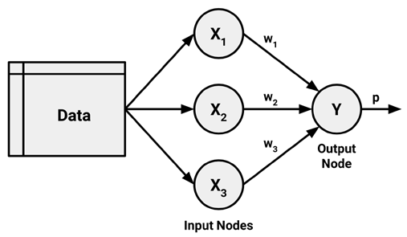
Single Layer Network

Slide 22
Multi-Layer Network

Slide 23
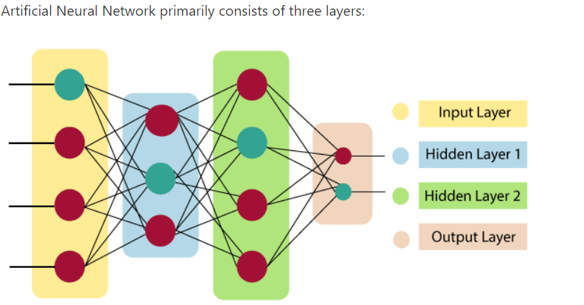

Slide 24

The artificial neural network takes input and computes the weighted sum of the inputs and includes a bias. This computation is represented in the form of a transfer function.
Notes:
a weight decides how much influence the input will have on the output. Biases, which are constant, are an additional input into the next layer

Slide 25
Direction of Information
You may have noticed that in the prior examples, arrowheads were used to indicate signals traveling in only one direction. Networks in which the input signal is fed continuously in one direction from connection to connection until it reaches the output layer are called feedforward networks.

Slide 26
In contrast, a recurrent network (or feedback network) allows signals to travel in both directions using loops.
This property, which more closely mirrors how a biological neural network works, allows extremely complex patterns to be learned.
The addition of a short-term memory, or delay, increases the power of recurrent networks immensely.
Notes:
Feedback ANN:
In this type of ANN, the output returns into the network to accomplish the best-evolved results internally. The feedback networks feed information back into itself and are well suited to solve optimization issues. The Internal system error corrections utilize feedback ANNs.

Slide 27
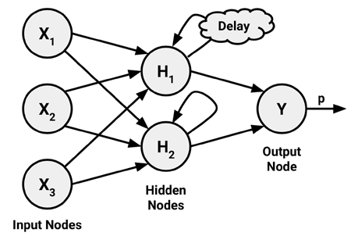

Slide 28
Number of Nodes
The number of input nodes is predetermined by the number of features in the input data. Similarly, the number of output nodes is predetermined by the number of outcomes to be modeled or the number of class levels in the outcome.

